Slide 1
Debating the science communication of climate change and GMO
Ana Delicado, Roberto Falanga, Jussara Rowland, Isabel Mendoza-Poudereux, Carolina Moreno, Empar Vengut-Climent, Belén Mañoguil, Giuseppe Pellegrini, Erik Hrnčiarik, Krzysztof Ciapala, Carolina Llorente, Edurne Gaston & Izabela Warwas

Slide 2
The problem
Public perceptions and opinions of scientific issues seldom match scientists’ perceptions and opinions (also among themselves - controversies)
Citizen practices (consumption, voting, health) are affected by knowledge of scientific issues
Scientific information reaches the public through many different channels and filters
Fake news, misinformation, distrust of experts have complicated further the relations between science and society

Slide 3
The CONCISE project
Title: Communication role on perception and beliefs of EU Citizens about Science
Funding: European Commission, H2020 – SwafS
Duration: December 2018 – November 2020
Coordinator: Carolina Moreno, University of Valencia
Consortium: 5 countries, 9 partners

Slide 4
CONCISE objectives
1. To increase our understanding of how beliefs, perceptions and knowledge of science and technology related issues originate among EU citizens;
2. To review the existing structural obstacles that scientist and other R&I stakeholders, including policy makers, currently face when attempting to communicate science successfully;
3. To evaluate the existing models for teaching science communication to communicators and scientists in Europe;
4. To enable active citizen participation in scientific research process, in line with the concept of responsible research and innovation (RRI), by employing a public consultation methodology;
5. To measure the positive or negative perception of citizens participating in the public consultation on a selection of stories related to science.

Slide 5
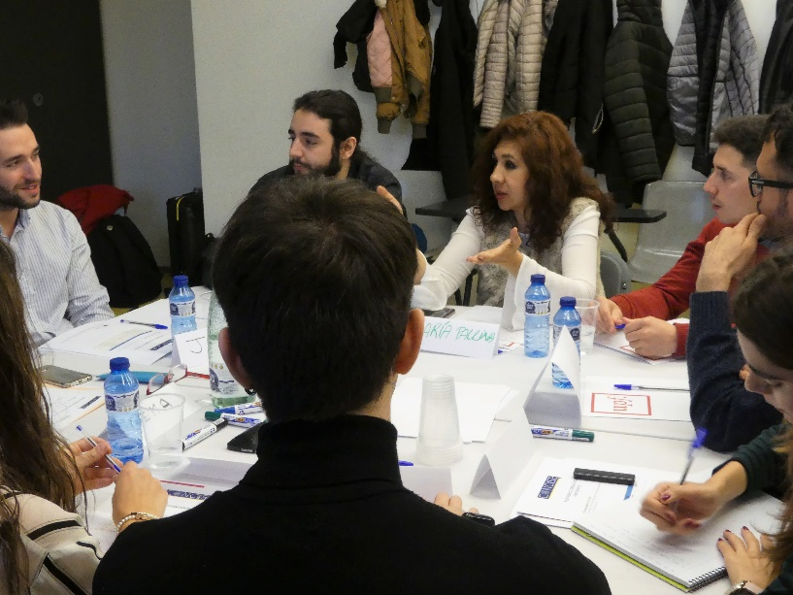
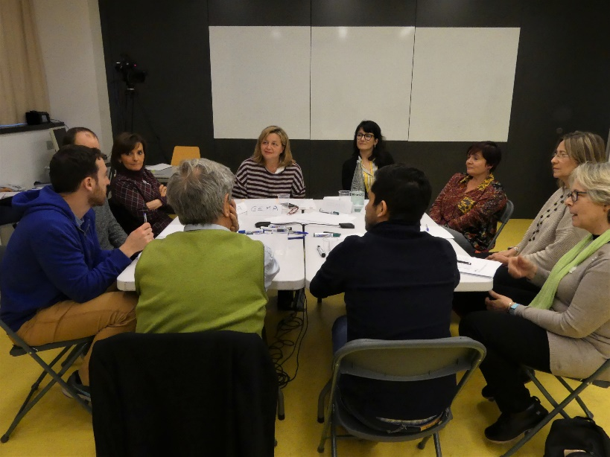
CONCISE methodology
Consultations with 100 citizens in each participating country, ensuring a diverse sample
Discussion of 4 topics: climate change, GMO, vaccines and complementary medicine
Issues for debate: how citizens perceive science communication, how individuals make decisions on science-related matters (e.g. vaccination), which information sources they use and find more credible
Table discussions (qualitative data) + semi-quantitative activity (survey) for each topic
Consultation in Portugal: 16th November 2019, at CCB, Belém

Slide 6
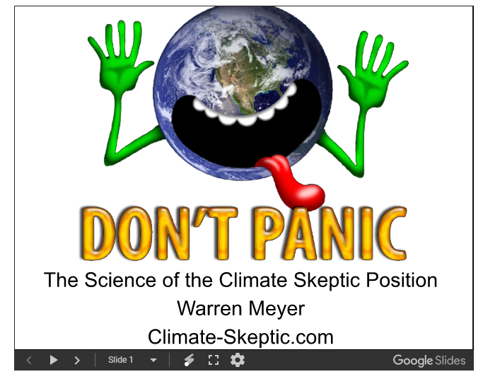
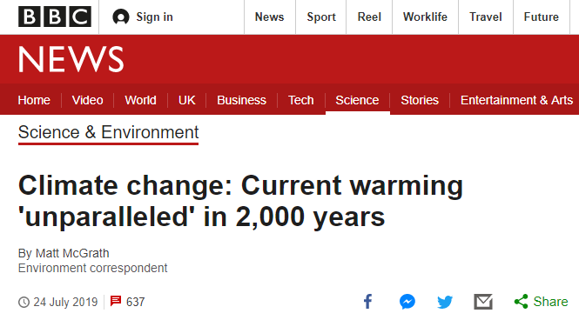
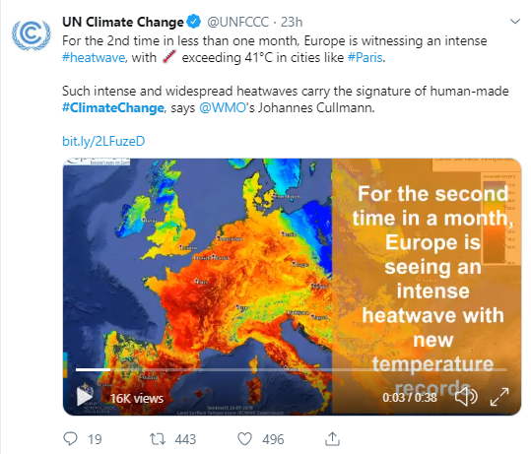
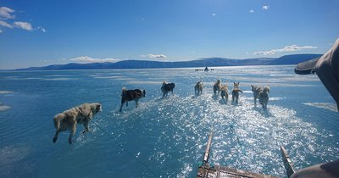
Debating climate change

Slide 7
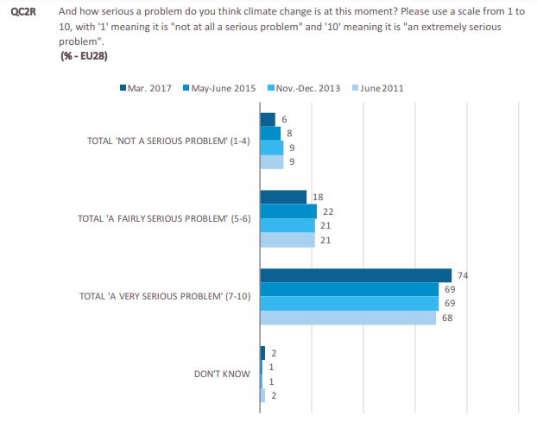
Debating climate change
Source: Eurobarometer, 2017

Slide 8
Debating climate change
Some topics for discussion
Do you remember any news about climate change? What was it about?
When you see news on the effects of climate change on television, do you think you can do something to stop it?
Do you remember in what situation you have heard/read/seen it?
Is climate change a topic on which you deliberately search for information? Why/why not?
If you receive information about climate change that you consider interesting, what do you do?
Can you think of someone who is a reference for climate change? Why her/him?
What would you change to make information about climate more interesting/complete/reliable?

Slide 9
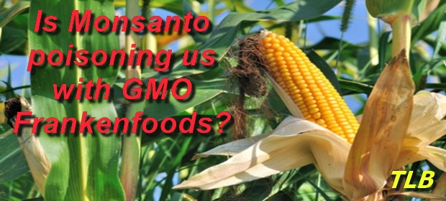
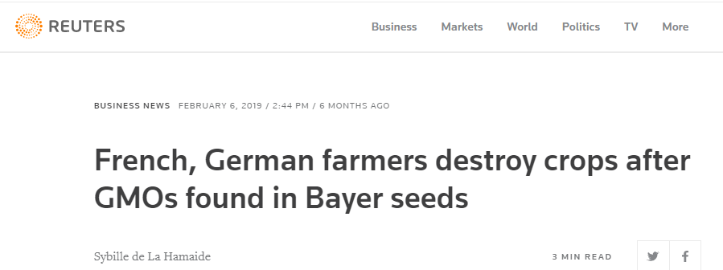
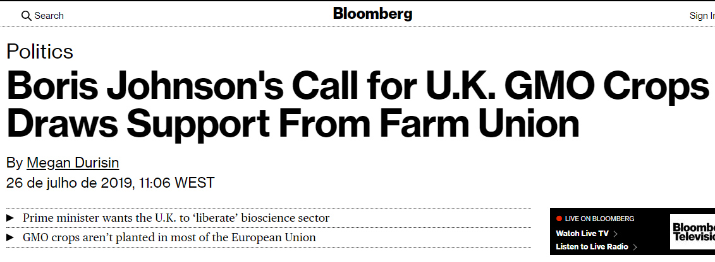
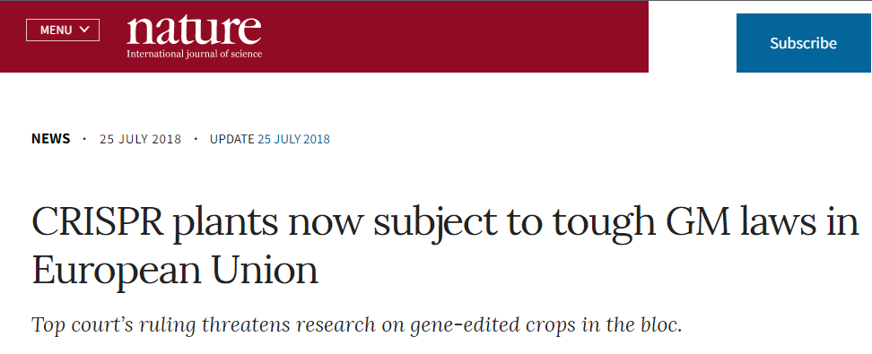
Debating GMO

Slide 10
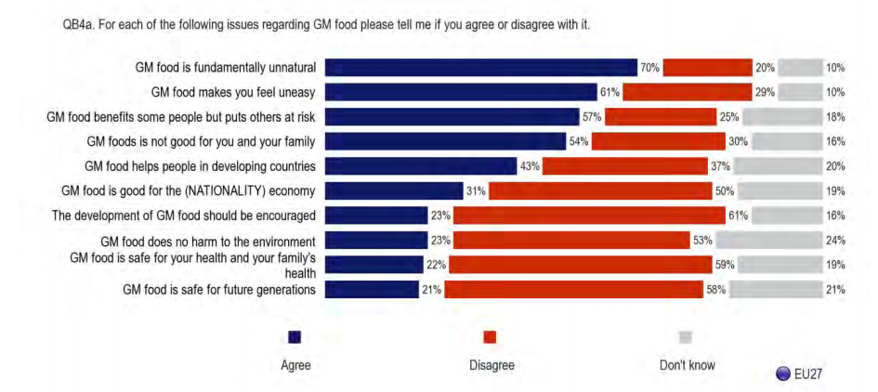
Debating GMO
Source: Eurobarometer, 2010

Slide 11
Debating GMO
Some of the topics for discussion
What can you tell me about genetically modified organisms?
Which sources of information do you think are more reliable about genetically modified organisms? And which aren’t? Why?
Have you ever searched on the Internet information on genetically modified organisms? What webs/sources?
Do you think that most scientists agree on the issues we are dealing with?
Can you tell me if you consume any product that includes genetically modified organisms?
Do you think you have enough information about this issue?
How this information can be improved?

Slide 12
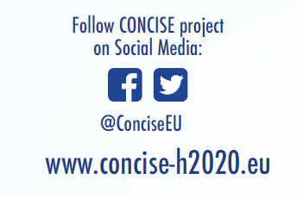
Want to know more about CONCISE?

